Slide 1
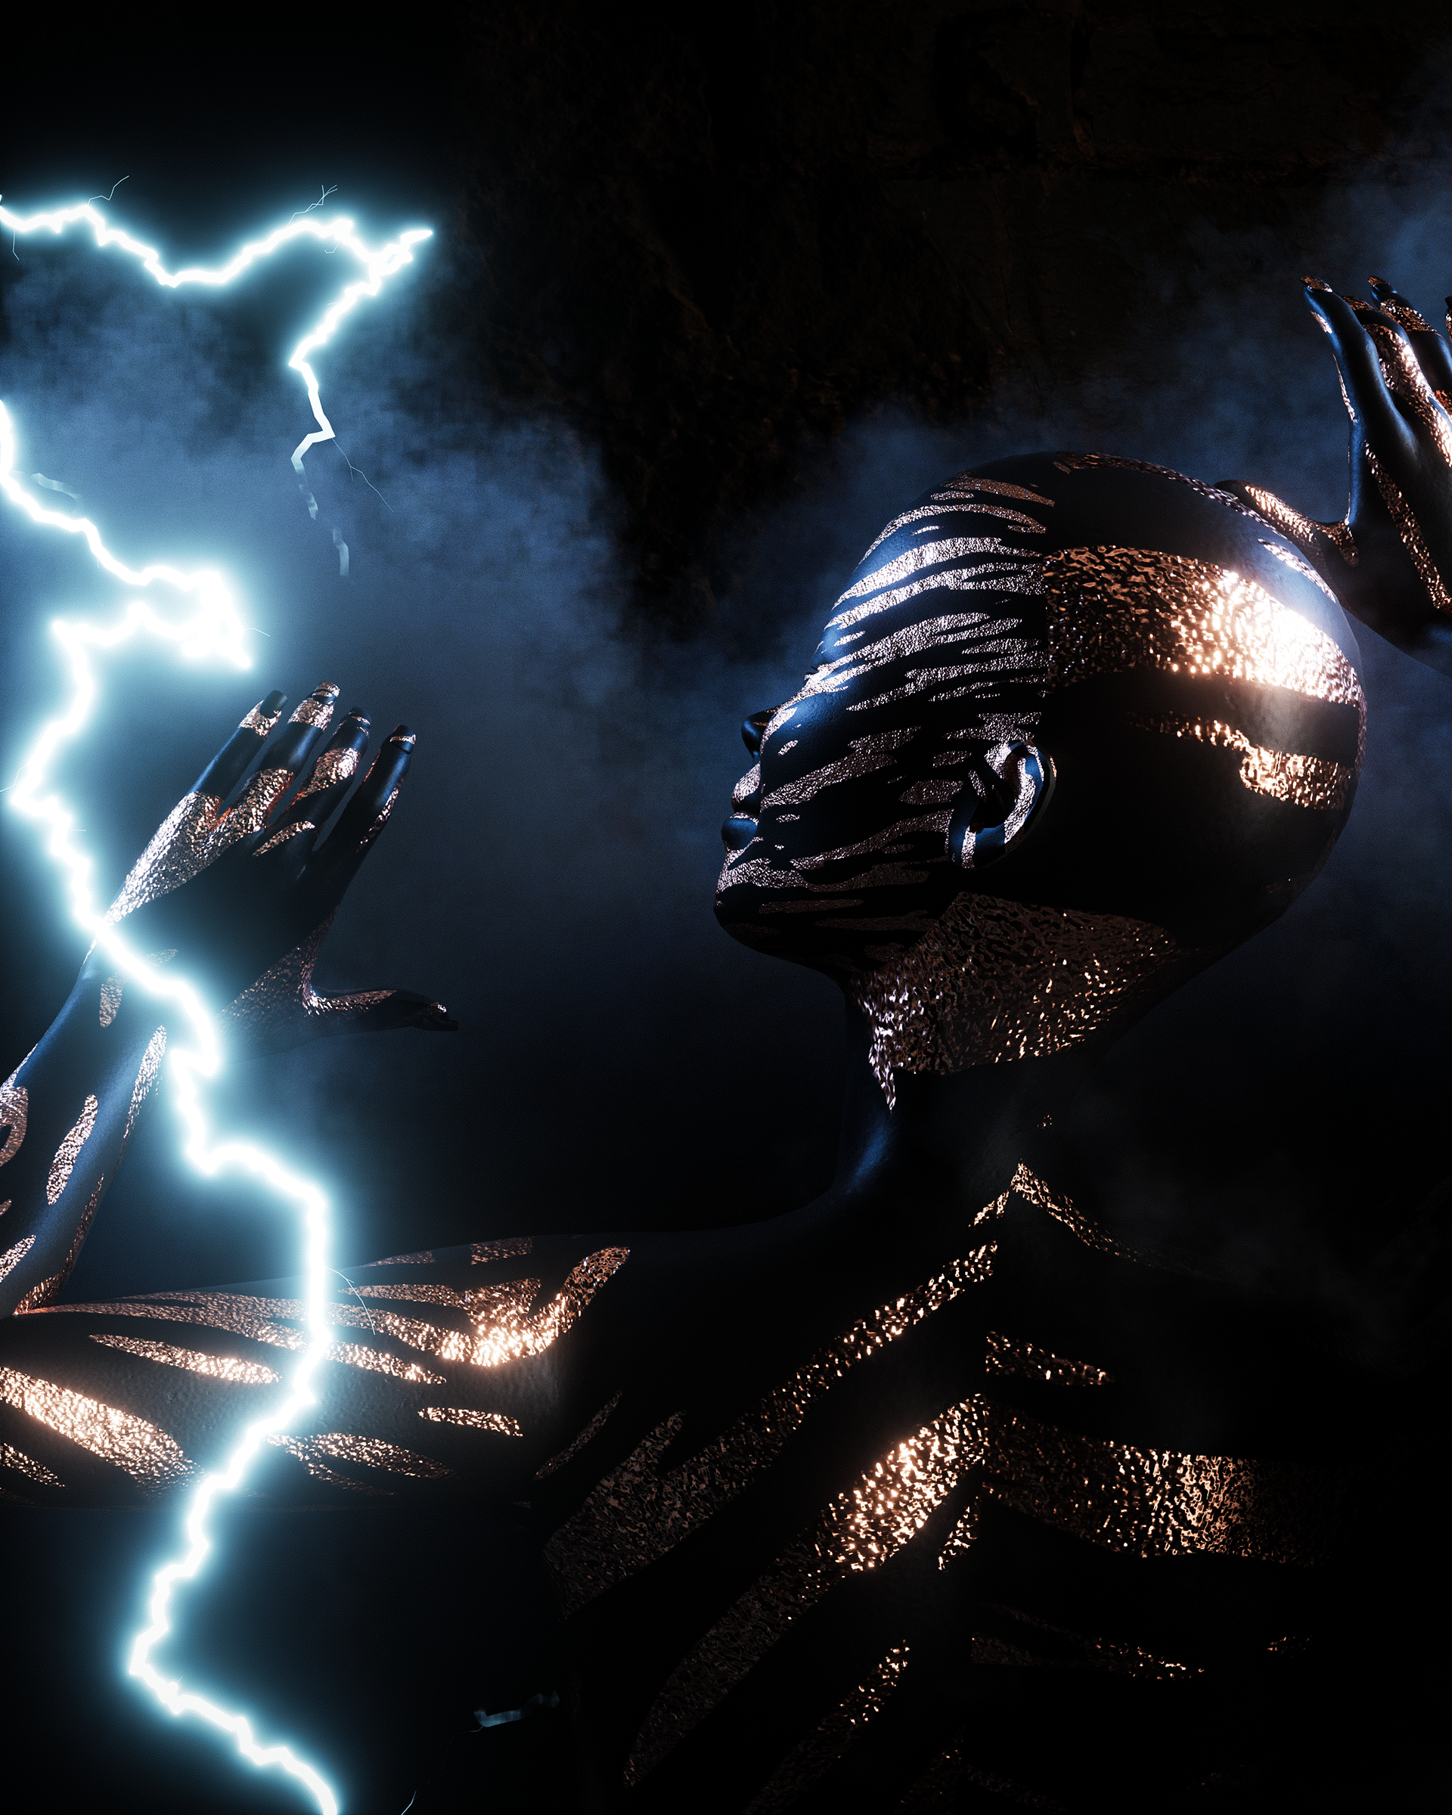
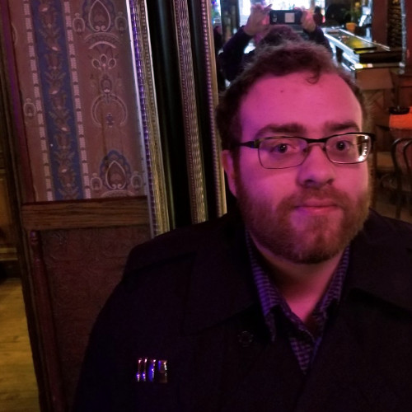

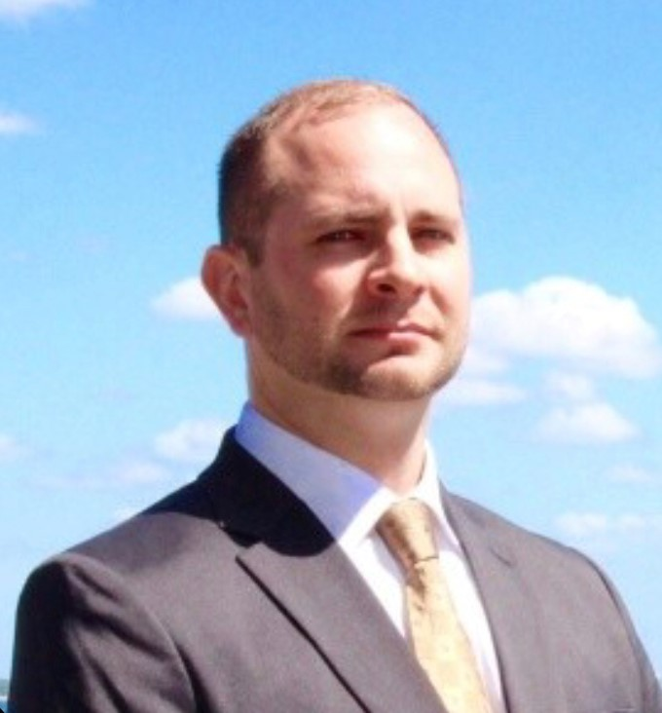
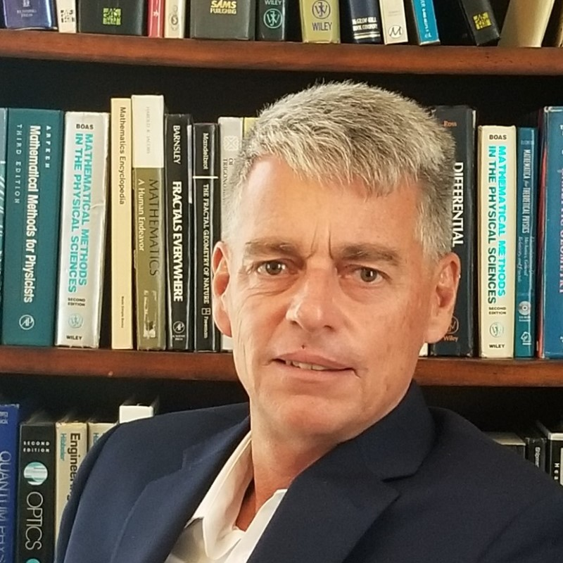

Cognitive Warfare
Zero Trust Architecture
Fog Computing
Energy Transformation
Human Protect Surface
Aerospace Research
Jason L. Lind
Coalition
Mitch Maddox
Command
Nick Chadwick
Operations
Don Fielden
Director / Nf3
partners@multiplex.studio
+1 414 788 2820

Slide 2
Mission Statement
"If you can't fly then run, if you can't run then walk, if you can't walk then crawl, but whatever you do you have to keep moving forward."
– Dr. Martin Luther King Jr.
In a world of rapidly evolving threats creating an environment of unparalleled risk we at MultiPlex.studio and Nf3.agency innovate at beyond the bleeding edge to manifest never before seen attack and defense vectors on behalf of the United States, NATO and the UN. Espousing an All-Domain approach with our efforts we understand the solutions to our crises lie in the Cyber-Space-Time-Thought continuum and therefore focus our efforts in manipulating cyber to affect thought in order to realize change in space-time.

Slide 3

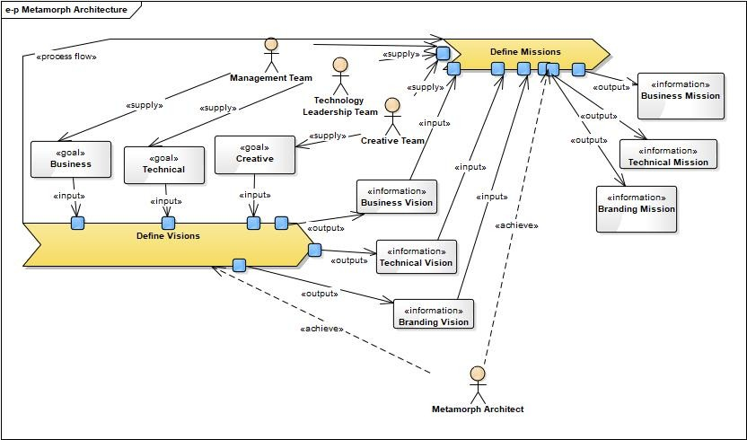
A
C
H
I
E
V
I
N
G
T
H
E
M
I
S
S
I
O
N
Metamorph: An organization undergoing transformation
THE
METAMORPH
ARCH
Jason Lind first proposed this methodology in October 2018 as an answer to the increasing abuse of the term “Transformation”.
The fact the “Business” and “Digital” often preface that term
is concerning as true Transformation must occur across the
continuum, at basic Business-Technology-Brand.
At MultiPlex.studio we employ a C3 management strategy:
COMMAND
COALITION
OPERATIONS

Slide 4
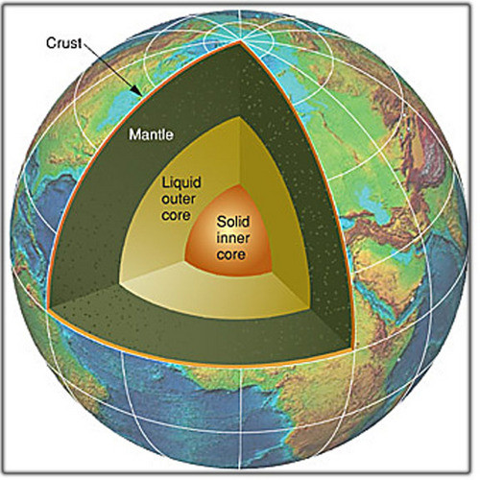
C3: Command, Coalition, Operations
In this management model, proposed by Jason Lind in August 2018 during the initial discussion of the USSF structure, Operations is considered a `C` since its level of importance is on par with Command and Coalition.
While the quote to the left is true, trust is only part of the equation to keep the rowing harmonious: the team must buy into the vision of the leadership and to do that we contend they must be an integral part of the process to set that vision. Leadership perspective is an out dated concept: organizations cannot just be led from the top but rather from within as well.
A row boat moves in the intended direction only if those rowing pull in harmony. Otherwise it drifts. Same in organizations. Leaders set the direction, determine the cadence, and nurture the trust necessary for the team to work in harmony. Otherwise they drift.
- Ret. Gen. Martin E. Dempsey, USA
Like the solid core (Command) of a planet directives bubble through the liquid outer core (Operations) and into mantle (Coalition).

Slide 5

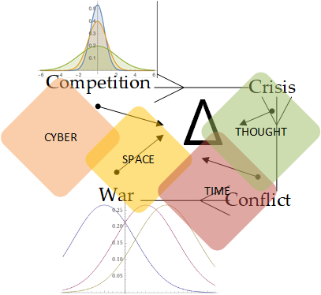
Why we are in the *game*
We are patriots, we are also for all of humanity – which is NEVER a conflict of interest. Developing international coalition cyber efforts is our top priority as we have participated in founding CYBERCOM at the US, NATO and UN levels.
To the right is a diagram describing the “Continuum of Adversity” where there are stages of Competition, Crisis, Conflict and War, all resulting in Change and occurring throughout the Cyber-Space-Time-Thought dimensions each having different Bayesian Probabilistic Reality curves.
At MultiPlex.studio we encourage Competition and Crisis, however work to limit Conflict and eliminate War such that the Change Vectors ultimately result in a stable global society such that our adversarial relationships are ultimately eliminated.

Slide 6

Capabilities Overview
In August 2020 MultiPlex was invited to develop a white paper surrounding the very new concept of “Cognitive Warfare” and submit to an RFI out of the Under Secretary of Defense for Research & Engineering (USD R&E). Our resulting paper, “A Cognitive Cyberwar” has been very well received in the community and we expect the resultant RFPs to reflect that.
Cognitive Warfare, for our purposes, is simply next-order Cyberwarfare, or “beyond the bits and bytes”. Social Engineering would be another synonym. Classical Game Theory is ultimately about making decisions – given rules and utility curves (and their associated payoff functions) who does what? Social Engineering on the other hand could be described as an applied branch of Game Theory where the rules and utility curves are altered – either in reality or just in meta – to adjust opponents play in reality. Bottom line CQW (Cognitive Warfare) is about bending information to the will of the beholder in order to manipulate the perceptions of our adversaries.
Cognitive Warfare

Slide 7
Capabilities Overview
In May 2020 we were tasked by USAF Cyberspace Dominance to prepare a deck describing the state of ZTA. In addition to “classic ZTA” we discovered Dr. Chase Cunningham’s Zero Trust eXtended (ZTX) which is a proper superset of ZTA and begins to have cognitive properties. Dr. Cunningham reviewed the work product before submission.
As part of our paper “A Cognitive Warfare” we introduced “Zero Trust Abstract” (ZT4) which introduces an Observe-Orient-Decide-Act level mapping through an extended OSI model that is 13 layers with the top being “Cognition/OODA”.
Zero Trust Architecture
Trust Not! – Verify Always

Slide 8

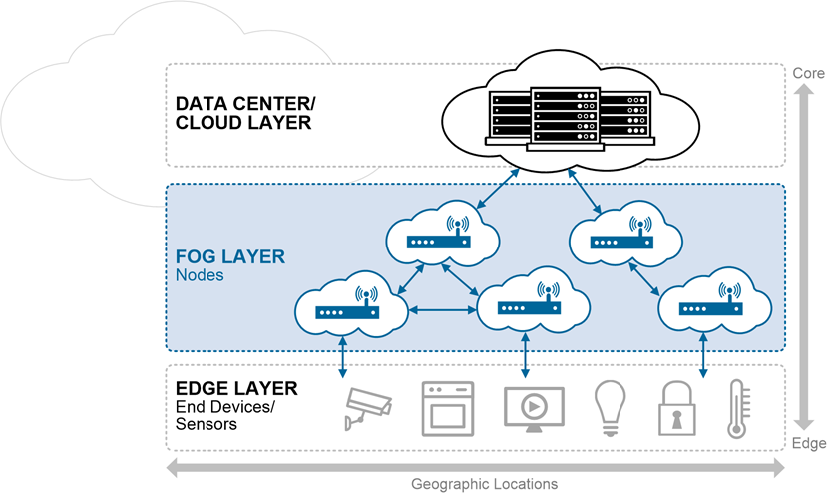

Fog Computing
Capabilities Overview
MultiPlex, along with out partners Technica & Basil Security, successfully were selected as one of 100/317 submitting to the AFWERX 2019 MDO Challenge and exhibited at AFWERX Fusion 2019. While we were not selected for the demo round this was an amazing experience and is the groundwork for all our indicatives.
The solution consists of a platform to collect data at the edge, perform validation and analysis (AI/ML) and stream those results to the cloud. Technica's SmartFog platform is leveraged for enabling seamless occasionally-connected streams from the Fog to the Cloud and Basil's Policy Enforcement Engine enables multi-level classification and data encryption.

Slide 9

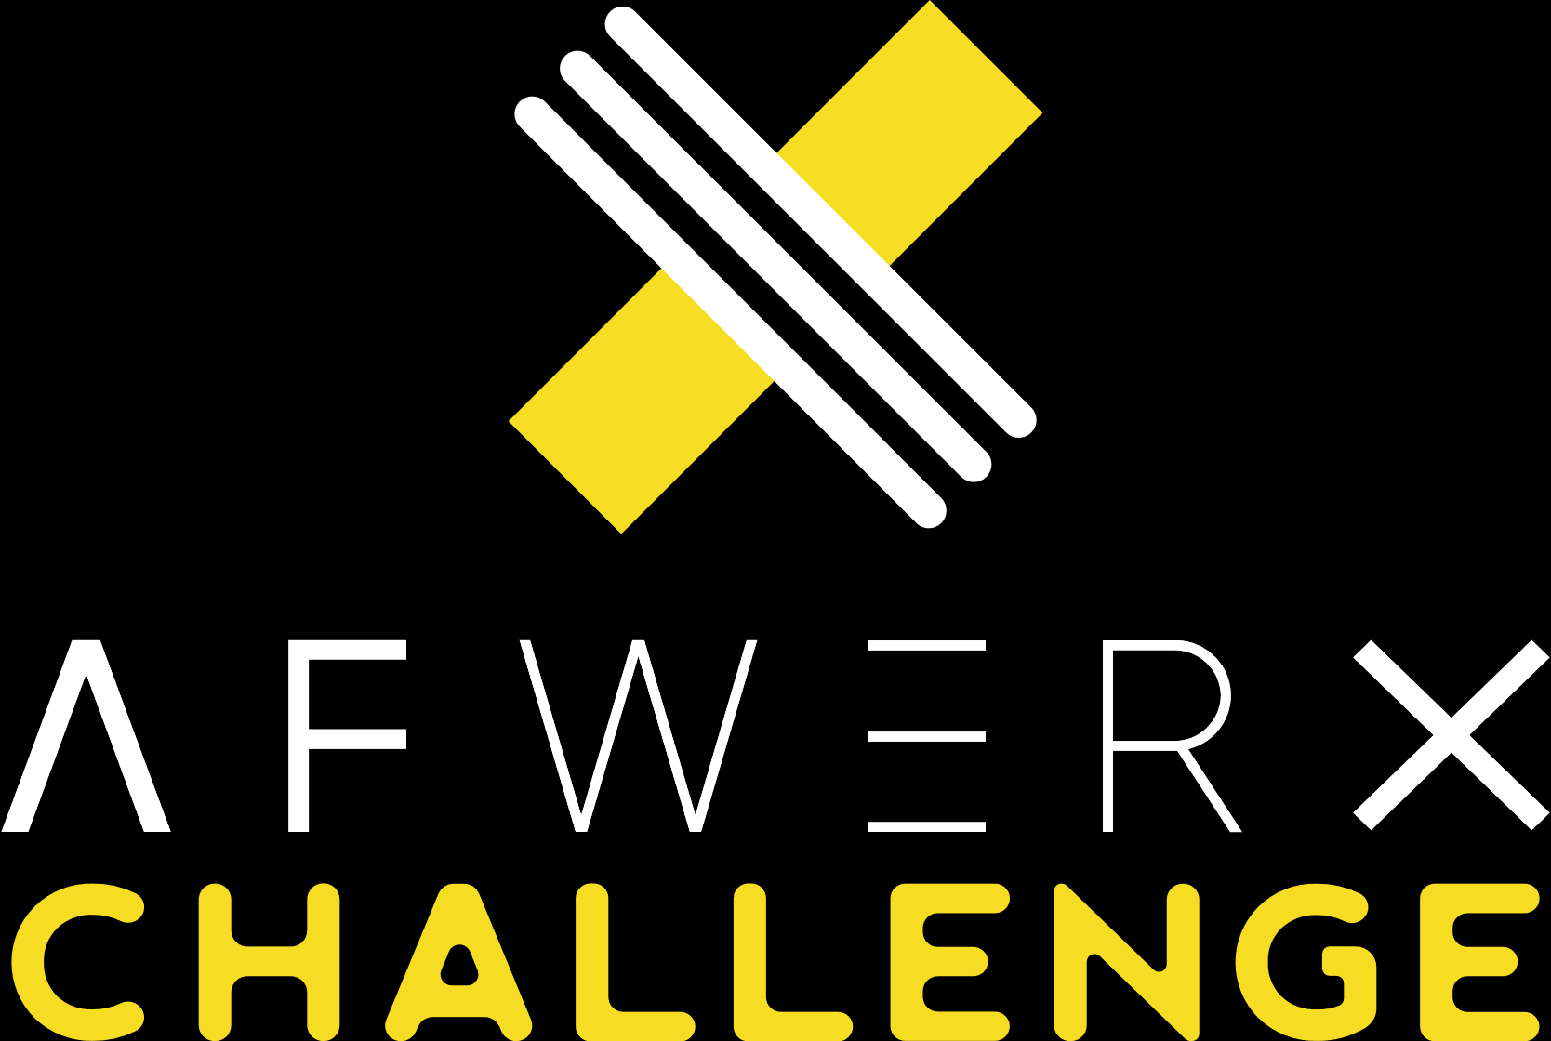

Reimagining Energy: Culture, Policy & Education
Capabilities Overview
Announced in August 2020, the AFWERX Reimagining Energy Challenge is a 6-part initiative to transform energy use through technology and policy.
Our solution: Energy-to-Value Efficiency Enabler: development.exchange => mil.StratML.services – Cognitive Warfare Realizing Syndicated Strategic Services where we both empower and shape cultures, inside and outside the DoD, through Cognitive Warfare techniques thus linking DoD core values to its mission work, tactical power generation, & operational energy consumption. mil.StartML.services is a proposed platform for syndicating strategy in C2 systems with downstream enforcement with upstream verification utilizing a decentralized, competitive market based approach.
We ultimately placed 3rd/out of 124 in our category with only one solution accepted for the showcase. A CSO with AFWERX remains on the table for this broad scope.

Slide 10
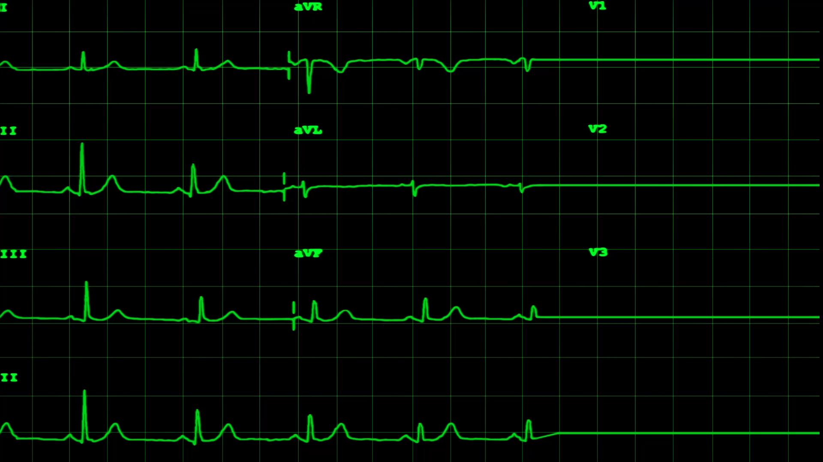
Securing the Human Protect Surface
Capabilities Overview
Historically base security has had a focus of maintaining a tight perimeter with additional perimeters configured at, and within building sites. Ostensibly this would be a proper application of Zero-Trust Architecture (ZTA) however this strategy is missing a key component: continuous evaluation of the protect surface.
The primary goals are to achieve the following:
Real-Time tracking of authorized members on the military GPS and milCloud infrastructure
Identify COTS or develop custom Android based Health Watch
Vitals monitoring to realize enhanced biomatics in addition to increased health monitoring
Deep Learning models to differentiate wearers of uniquely identified wearables as individuals – when coupled with a HUF (Hardware-Unique-Factor) enabled device this would provide constant presence of identity
Analyze a combination of temperature, blood pressure, and pulse-ox to identify potential COVID-19 infections and aid in contact tracing
Provide real-time health statistics to prioritize rescue/evacuation
This project is intended to be a “curated” Q2 2021 USAF SBIR Phase I opportunity.
Presence of Identity
Security Factors
Biomatics
Position

Slide 11

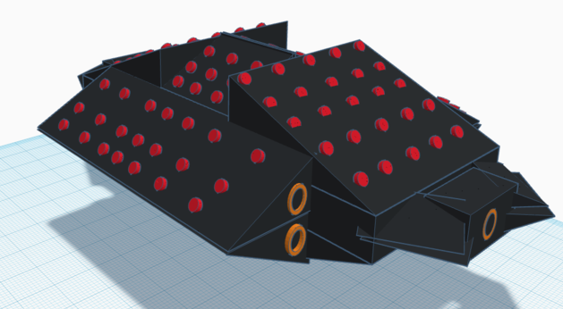
Advanced Conceptual Aerospace Research
In addition to cyber/tech we also have a theoretical working group on Advanced Aerospace Design. At the center is NexCraft: A "UFO" on a 10 year time frame, originally presented to AFWERX in March 2018 this project is under active development with the last publish being reflected in July 2019. NexCraft is smothered in micro-rocket-engines with main boosters providing fixed-vector-thrust-propulsion. Theoretically it can be going along at Mach 3, spin into a curve at Mach 5, stop on a dime and (if weaponed) take an entire wing of enemy fighters out of the sky before even been detected. Additionally it can do a "controlled spin" out of the atmosphere and navigate space even easier than within Earth.
Additionally in September 2020 we designed a conceptual ultra-large body prop-plane the 808Z, which employs artificial intelligence to oscillate - instead of spin - the blades: theoretically resulting in superior performance (fuel consumption & speed).
Capabilities Overview
Our objective is to advance and warp cyber-space-time-thought

